Slide 1
Topics
The Ownership and Management of Firms.
Production.
Short-Run Production: One Variable and One Fixed Input.
Long-Run Production: Two Variable Inputs.
Returns to Scale.
Productivity and Technical Change.
6-<number>

Slide 2
What is a firm?
Firm - an organization that converts inputs such as labor, materials, energy, and capital into outputs, the goods and services that it sells.
  Sole proprietorships are firms owned and run by a single individual.
  Partnerships are businesses jointly owned and controlled by two or more people.
  Corporations are owned by shareholders in proportion to the numbers of shares of stock they hold.
6-<number>

Slide 3
What Owners Want?
Main assumption: firm’s owners try to maximize profit!
Profit (π) - the difference between revenues, R, and costs, C:
π = R – C
6-<number>

Slide 4
What are the categories of inputs?
Capital (K) - long-lived inputs.
  land, buildings (factories, stores), and equipment (machines, trucks)
Labor (L) - human services
  managers, skilled workers (architects, economists, engineers, plumbers), and less-skilled workers (custodians, construction laborers, assembly-line workers)
Materials (M) - raw goods (oil, water, wheat) and processed products (aluminum, plastic, paper, steel)
6-<number>

Slide 5
How firms combine the inputs?
Production function - the relationship between the quantities of inputs used and the maximum quantity of output that can be produced, given current knowledge about technology and organization
6-<number>

Slide 6
Production Function
Production
Function
q = f(L, K)
Inputs
(L, K)
Output
q
Formally,
q = f(L, K)
  where q units of output are produced using L units of labor services and K units of capital (the number of conveyor belts).
6-<number>

Slide 7
Time and the Variability of Inputs
Short run - a period of time so brief that at least one factor of production cannot be varied practically
  Fixed input - a factor of production that cannot be varied practically in the short run.
  Variable input - a factor of production whose quantity can be changed readily by the firm during the relevant time period
Long run - a lengthy enough period of time that all inputs can be varied
6-<number>

Slide 8
Short-Run Production
In the short run, the firm’s production function is
q = f(L, K)
  where q is output, L is workers, and K is the fixed number of units of capital.
6-<number>

Slide 9
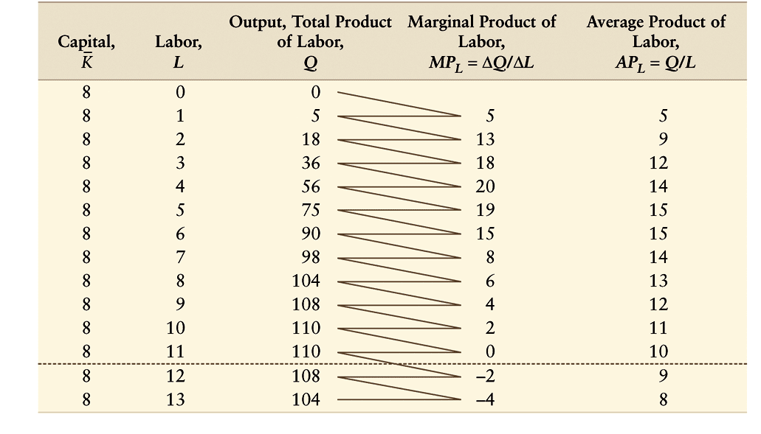
Table 6.1 Total Product, Marginal Product, and Average Product of Labor with Fixed Capital
6-<number>

Slide 10
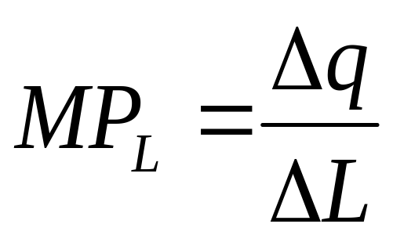
Marginal Product of Labor
Marginal product of labor (MP_{L} ) - the change in total output, Δq, resulting from using an extra unit of labor, ΔL, holding other factors constant:
6-<number>

Slide 11
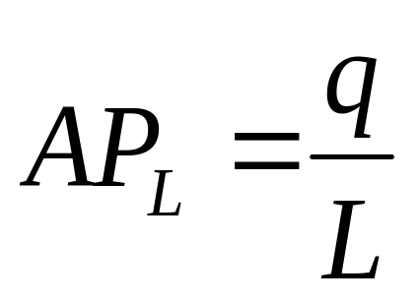
Average Product of Labor
Average product of labor (AP_{L} ) - the ratio of output, q, to the number of workers, L, used to produce that output:
6-<number>

Slide 12
Total Product of Labor
Total product of labor- the amount of output (or total product) that can be produced by a given amount of labor
6-<number>

Slide 13


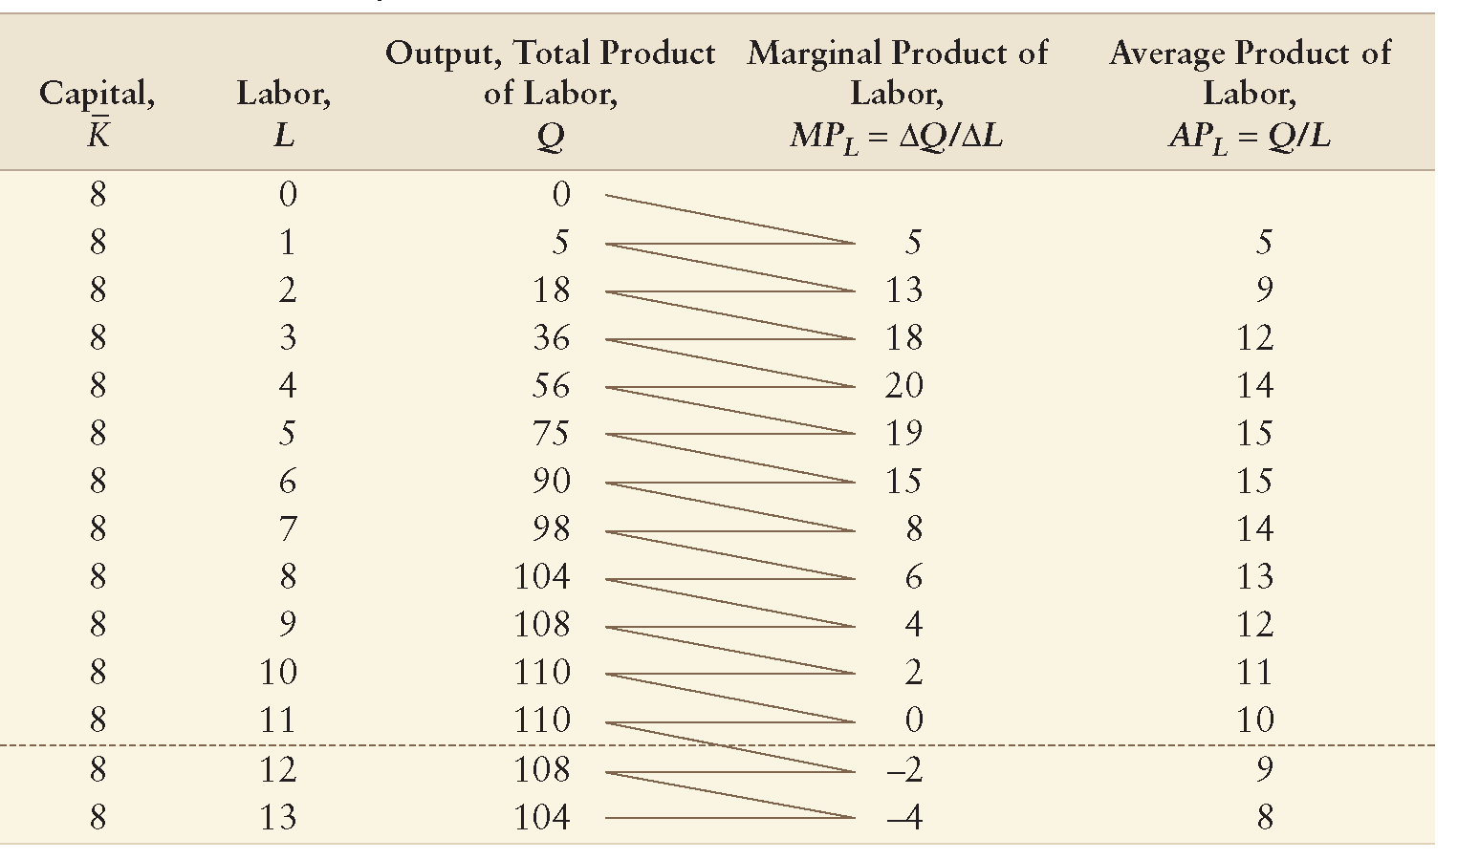
Figure 6.1 Production
Relationships with Variable
Labor
(a)
110
C
90
B
Output, q, Units per day
56
A
Diminishing Marginal Returns sets in!
0
4
6
11
(b)
L, Workers per day
L
20
a
MP
,
L
AP
15
b
Average product, AP_{L}
Marginal product, MP_{L}
11
c
0
4
6
L, Workers per day
6-<number>

Slide 14
Law of Diminishing Marginal Returns
If a firm keeps increasing an input, holding all other inputs and technology constant, the corresponding increases in output will become smaller eventually.
  That is, if only one input is increased, the marginal product of that input will diminish eventually.
6-<number>

